Slide 1
CI op per år och antal inskrivna på specialskolor fram till 2013
Slides presented at
http://www.ncfie.se/
20014 Oct 1
by
Prof. Hans Rosling
Karolinska Institutet, Stockholm
Swedish Academy of Science
www.gapminder.org
Graphs compiled by Ola Rosling

Slide 2
Children 0-4 years CI operation per year Sweden
60
40
20
2000
2005
2010

Slide 3
Children 5-10 years CI operation per year Sweden
20
10
2000
2005
2010

Slide 4
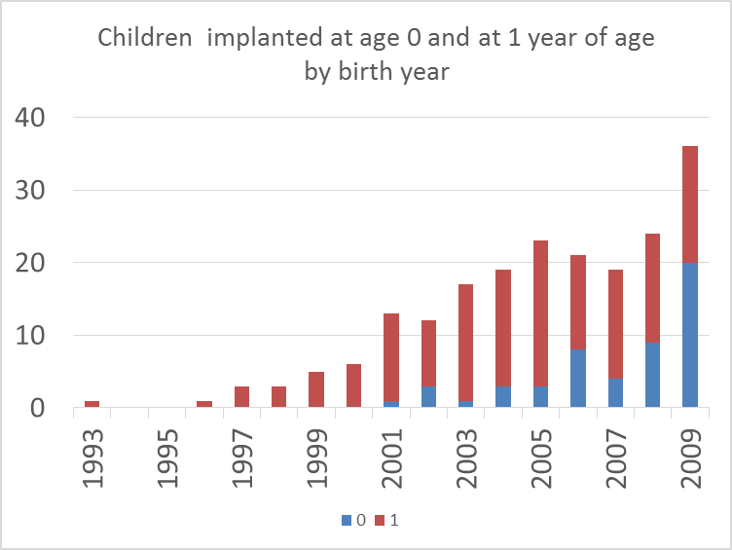

Slide 5
Reynell speach understanding
CI operation 2.0- 2.5 years
8
8
7
7
6
6
5
5
4
4
Developmental age [years]
3
3
2
2
1
1
0
0
0
0
1
1
2
2
3
3
4
4
5
5
6
6
7
7
8
8
Age in years
Karltorp E. 2014

Slide 6
Reynell speach understanding
CI operation 1.0- 1.5 years
8
8
7
7
6
6
5
5
4
4
Developmental age [years]
3
3
2
2
1
1
0
0
0
0
1
1
2
2
3
3
4
4
5
5
6
6
7
7
8
8
Age in years
Karltorp E. 2014

Slide 7
Reynell speach understanding
CI operation < 9 months
8
7
6
5
4
Developmental age [years]
3
2
1
0
0
1
2
3
4
5
6
7
8
Age in years
Karltorp E. 2014

Slide 8
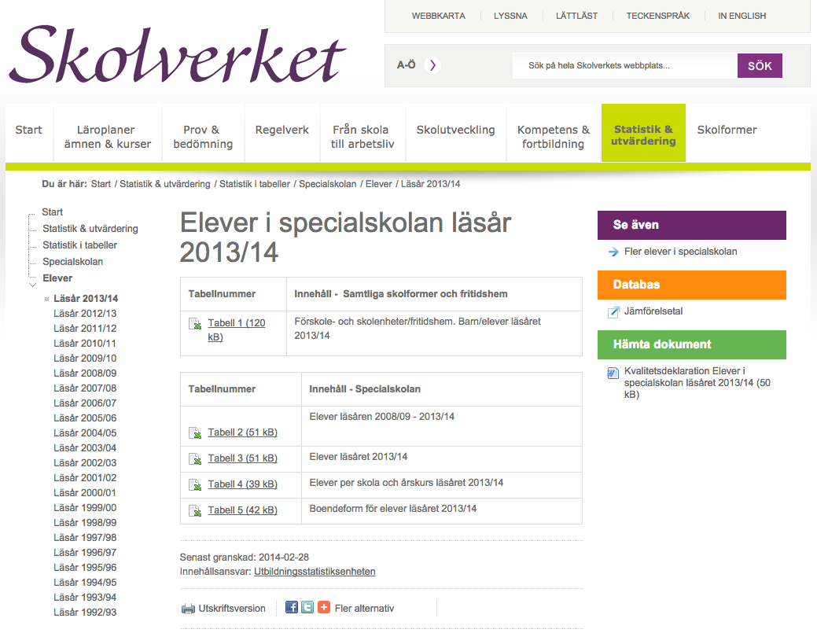
What the stacked bar means
Quick visualization of trends in the number of students by age in five Swedish Specialskolor by Hans & Ola Rosling, 2014 Oct 1, Questions: ola.rosling@gapminder.org

Slide 9
Number of enrolled students
Next slides show the number of students in three equal size grade-groups.
Låg: grade 1-3
Mellan: grade 4-6
Hög: grade 7-9
The number of children in higher grades is slightly higher than lower grades, because of late-comers. But the general trends is still falling dramatically across most schools (except Östervångsskolan)

Slide 10
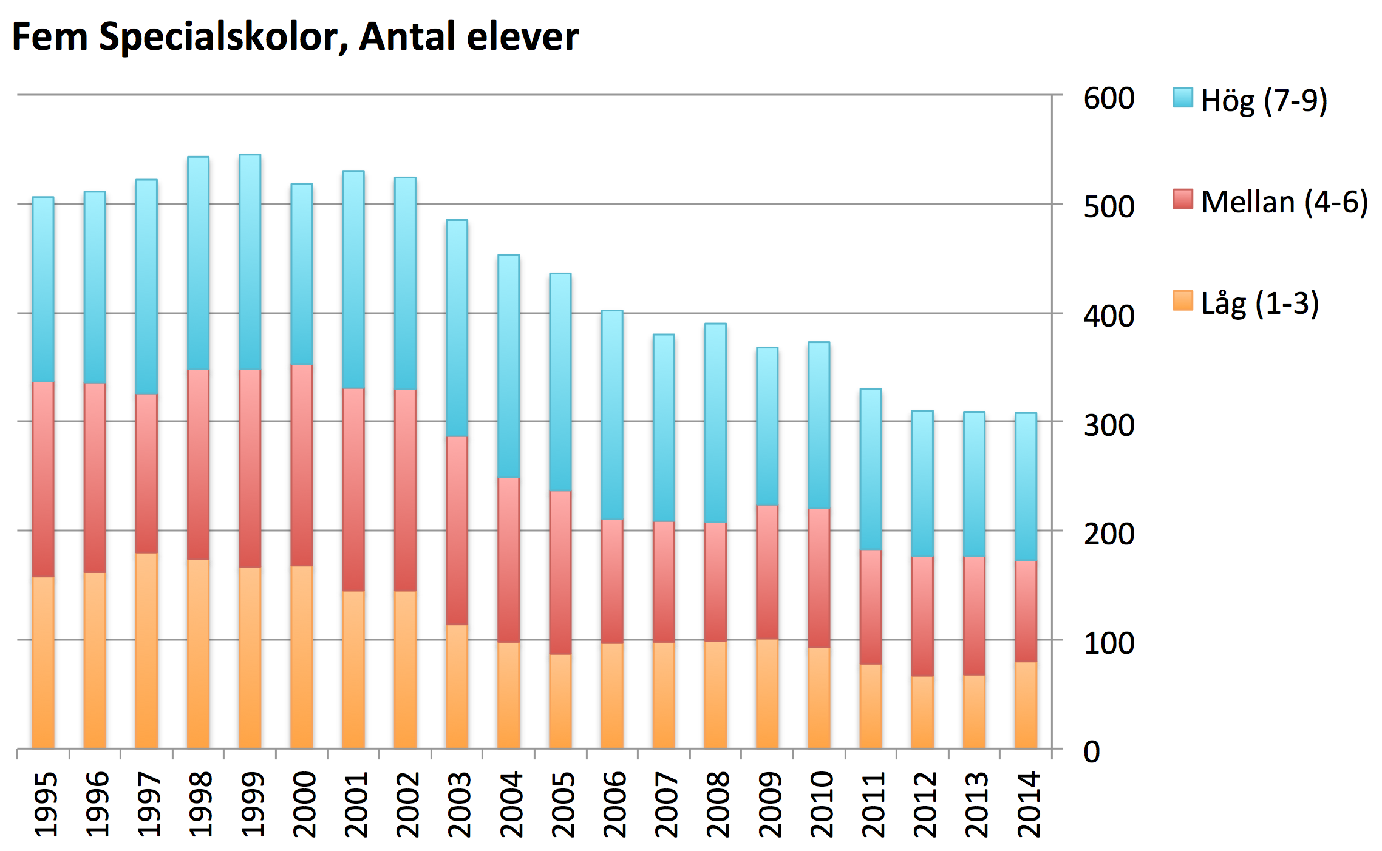
Årskurser 1-9

Slide 11
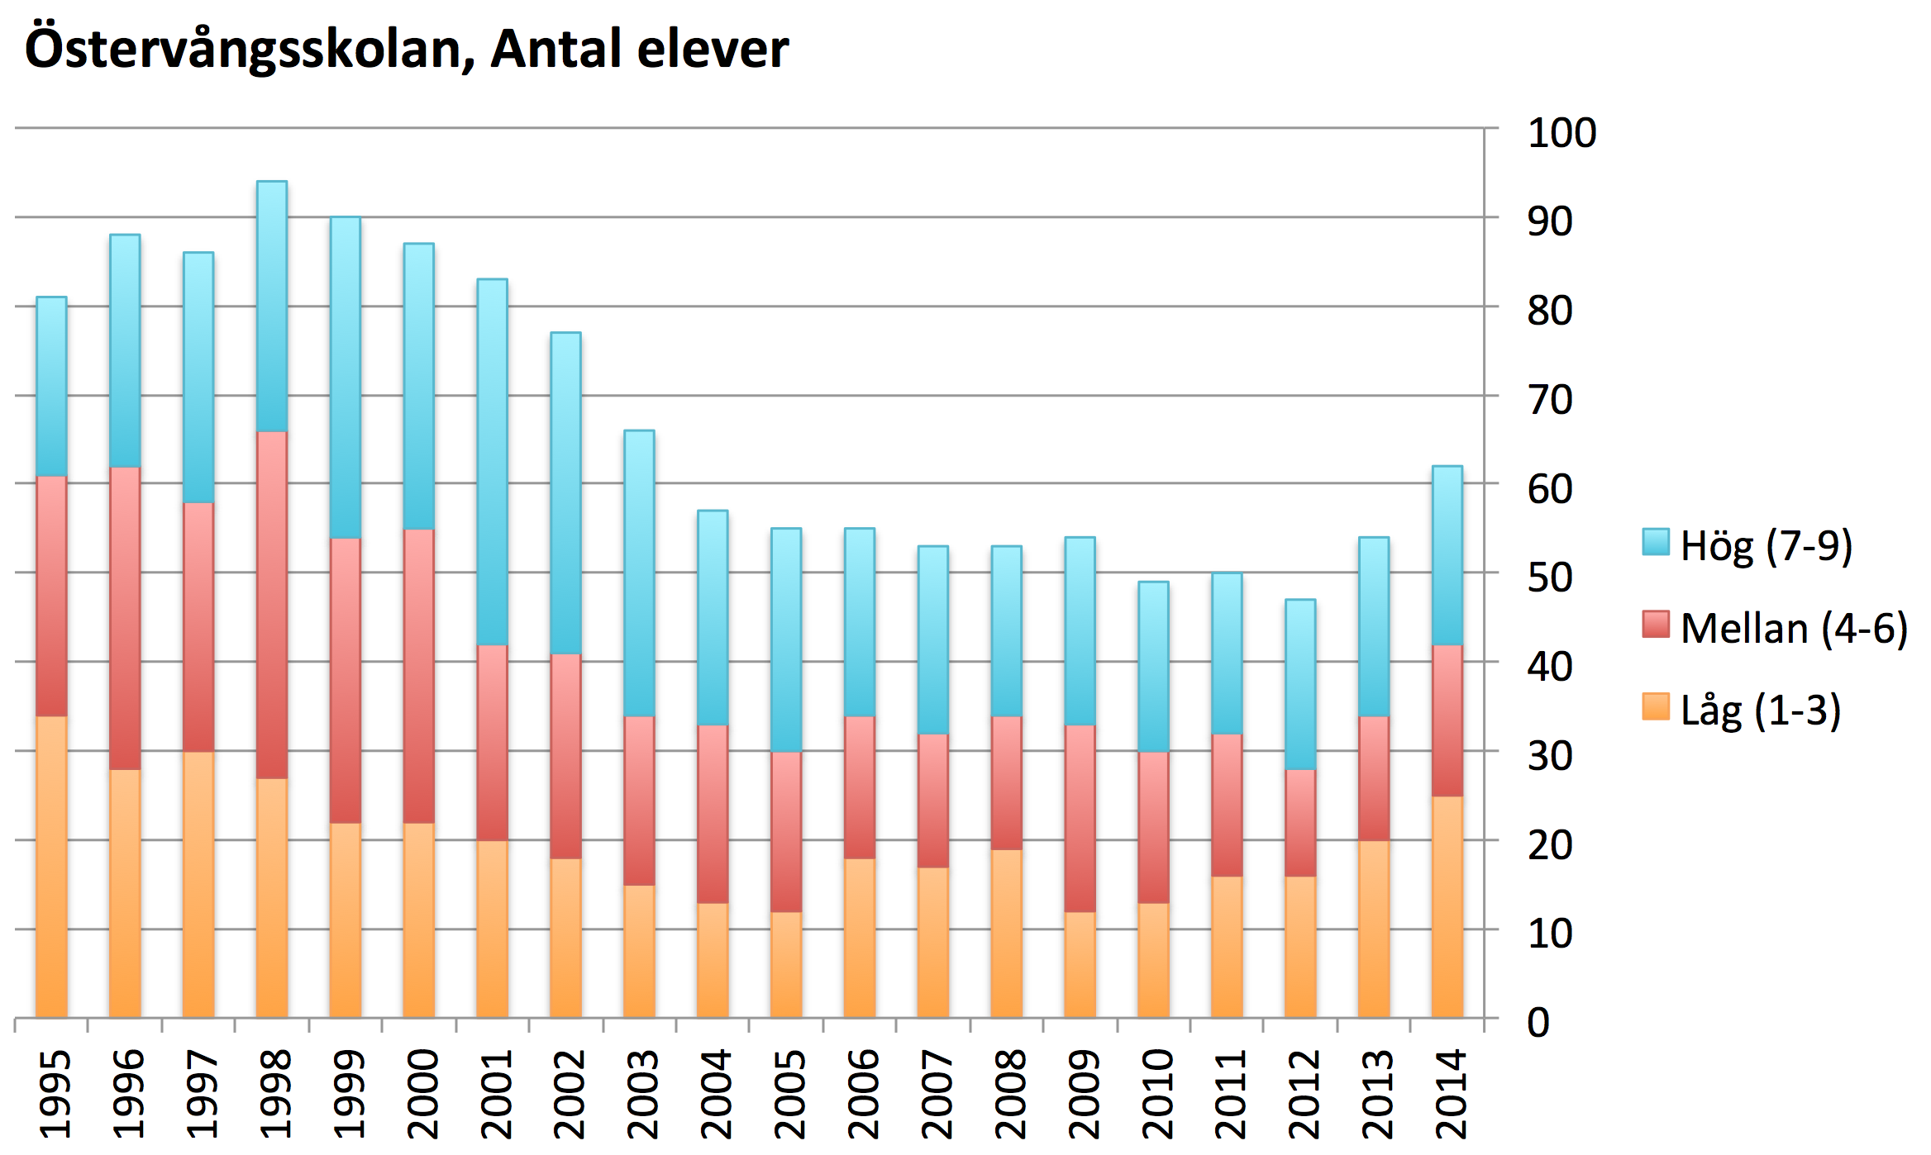
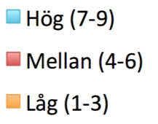
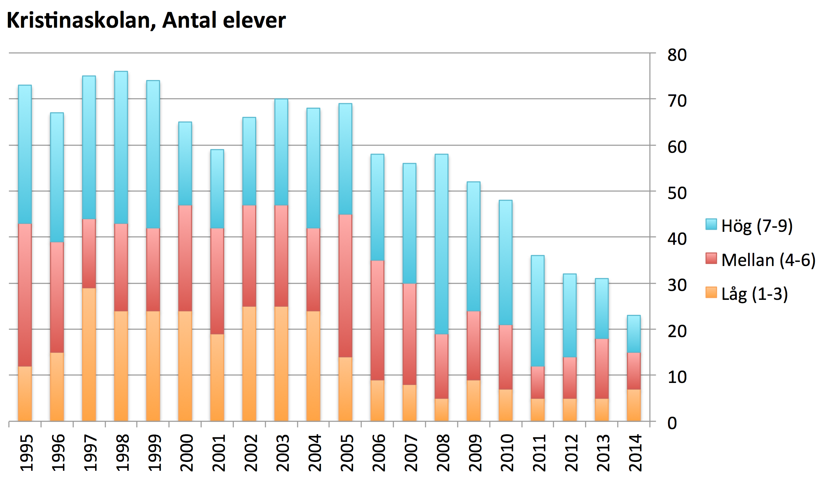
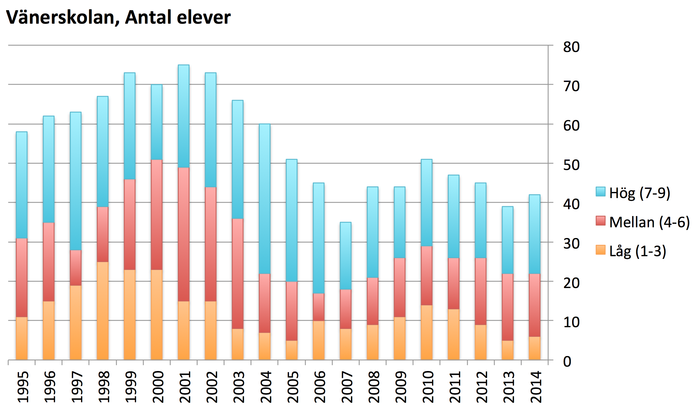
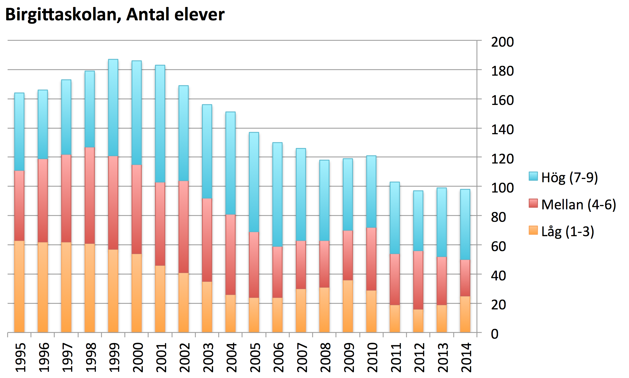
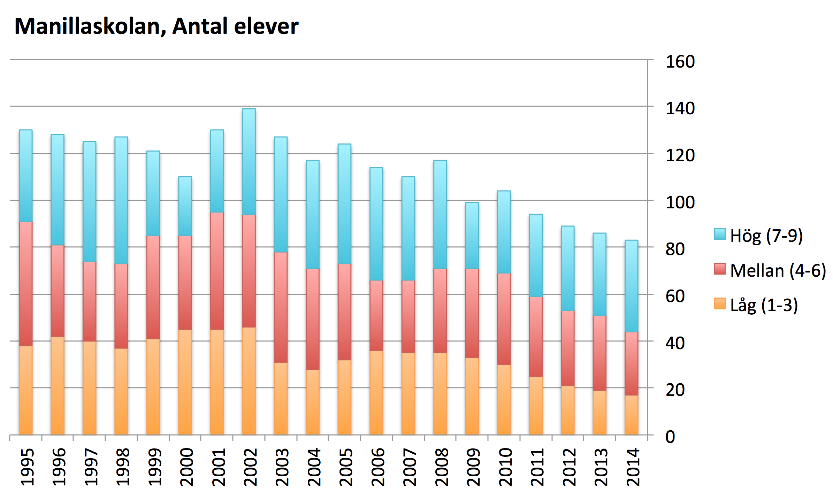

Slide 12
Årskurser 1-9
Exception to
the general trend

Slide 13
Årskurser 1-9

Slide 14
Årskurser 1-9

Slide 15
Årskurser 1-9

Slide 16
Årskurser 1-9

Slide 17
What happens to a cohort?
Next couple of slides show the changes in classes based on the year the first students started. It shows how new students are added later and how they drop out.
The Specialskolor have a large proportions of “late-comers” as well as a high drop out rate.

Slide 18
What the stacked bar means
Each bar shows a students of the same age; a cohort (think school-class). The based on the year they started first grade. Each bar is like a school class of same age children. The green shows those added to the class during ten years, and those falling down below the line shows the children leaving the class.
A
10 children started
the class in 2002
B
10 additional children joined them during the next 10 years
This class full history of additions and drop-outs displayed in one bar
2011
Here’s an example showing how the bar is built up for children starting school year 2002
2009
+2
20
+2
2008
18
2006
+1
2005
+1
16
+2
2003
14
+2
Total
Late
Arrivers
12
2002
10
17 children
finishing
10:th year
8
8 remaining
From the original children started
6
4
Adjust for drop-outs
2
0
Total
drop-outs
C
2 children dropped
out sometime during the 10 years

Slide 19
DATA CAVEAT
When producing these graphs, we didn’t have access to detailed student’s records. It is possible there were far more drop-outs and late comers. We only display the net difference in the class, by taking one year minus previous year.
Some drop-outs may be moving to a younger class, where they will show up as a late comer.
The same student’s may also come back in a later year, we don’t know. Some of the drop-outs should be green. Now all drop outs appear to be from the children who started.
As we only had access to data from 1995 to 2014, it’s important to keep in mind that the last nine age-groups haven’t completed their full track of ten years. The children starting in 2012, for example, their class have only gone through 2 years of change, whereas those starting in 2002 have already completed the ten years.
Ola Rosling ola@gapminder.org

Slide 20
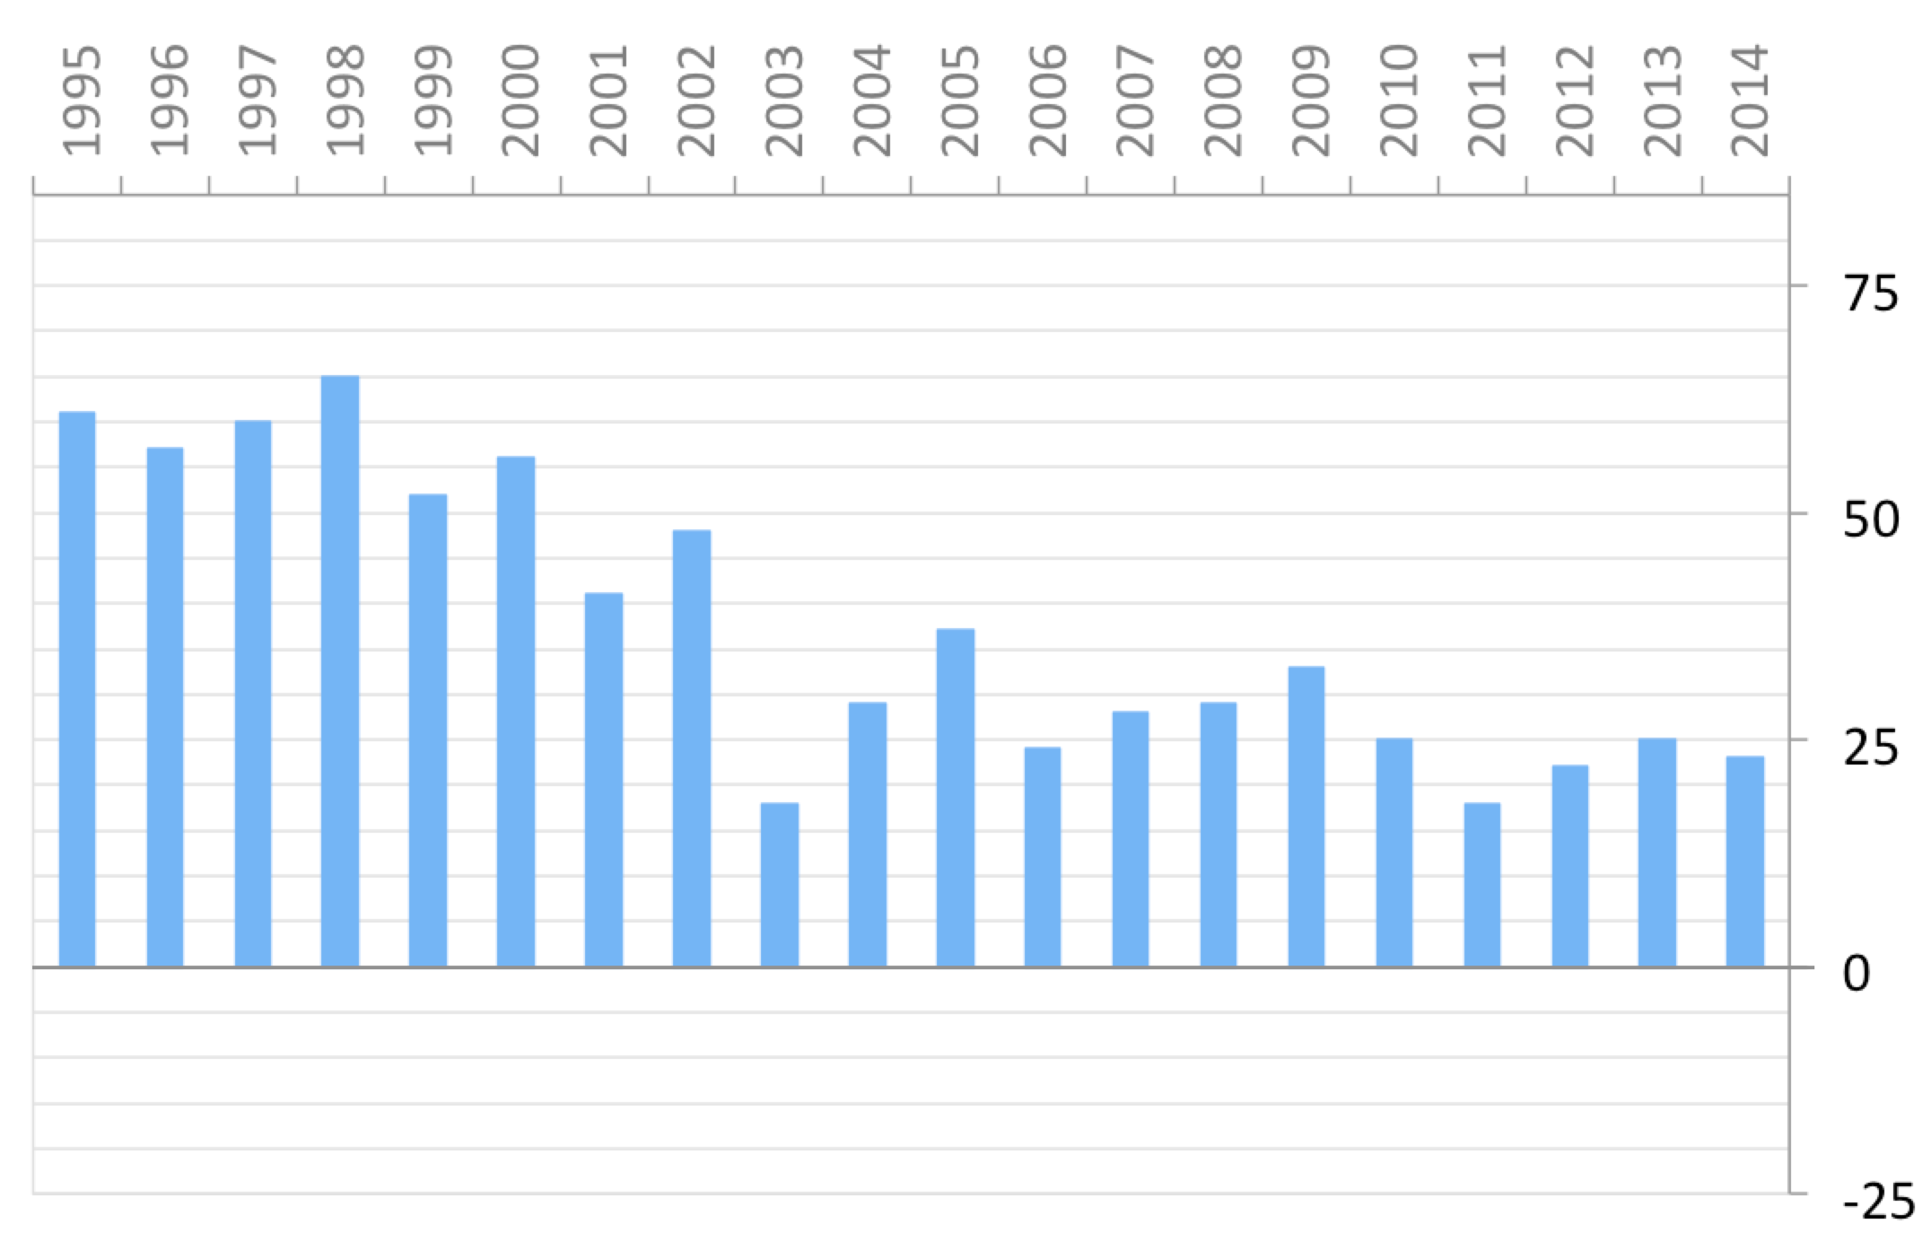
Five Specialskolor
(Number of students by age group)
Started first grade

Slide 21
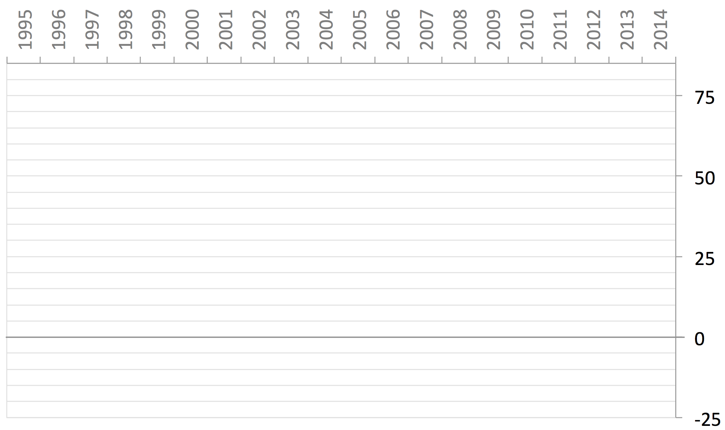
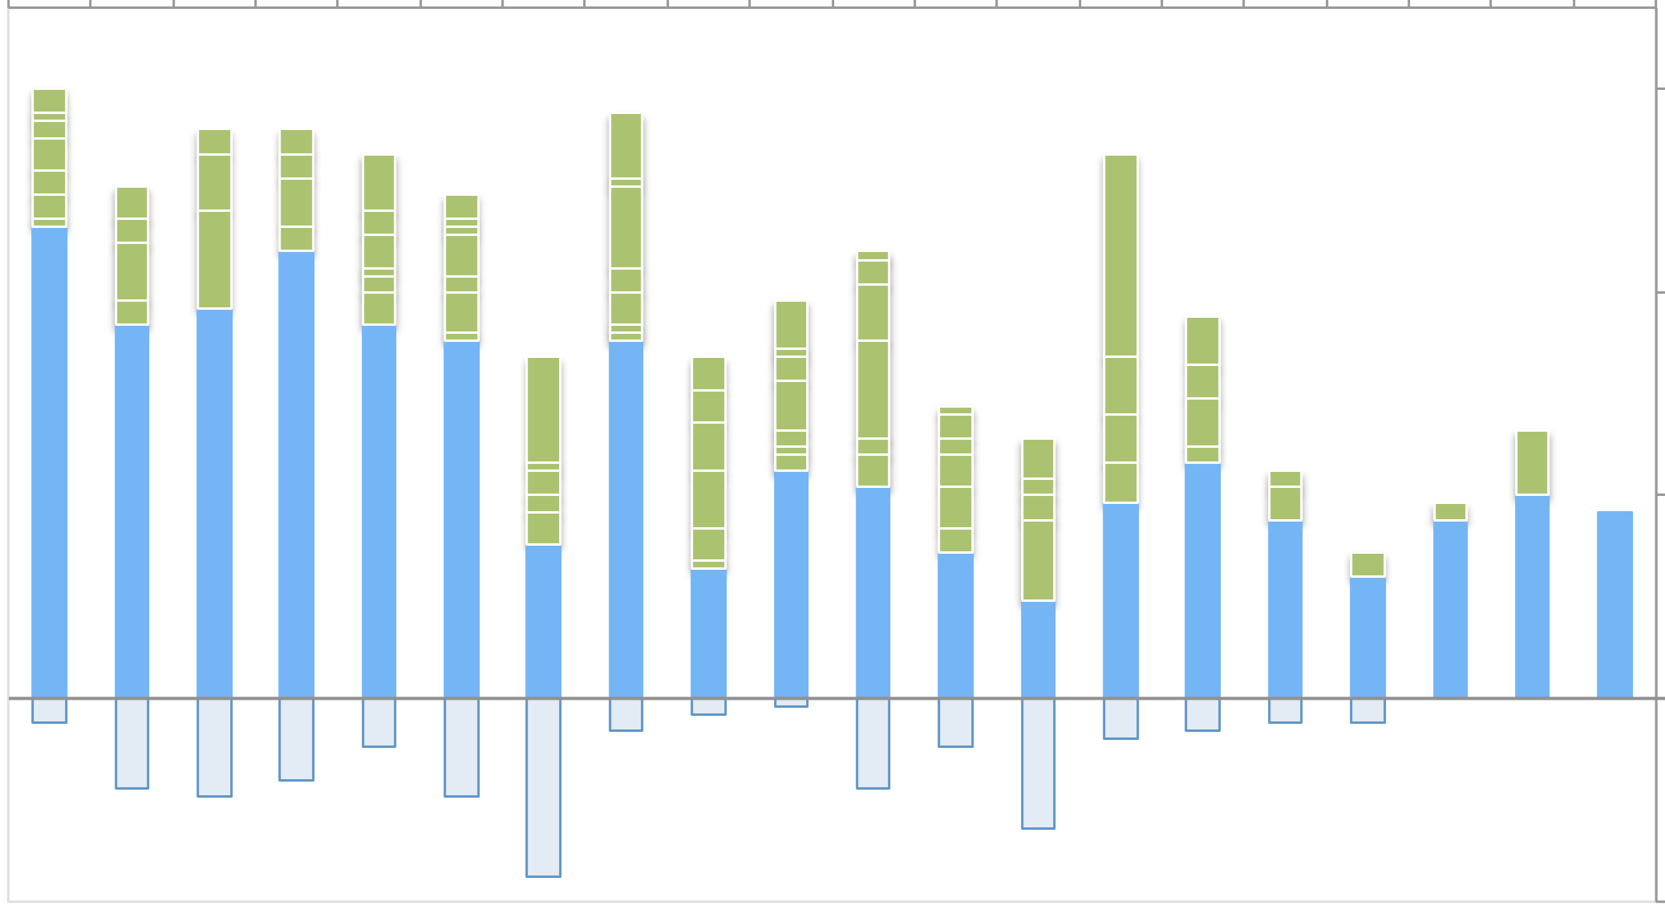
Five Specialskolor
(Number of students by age group)
Started first grade
Arrived later
Dropped out
363 students currently enrolled in grades 1 to 10.
Notice that more students may still arrive late and/or drop out

Slide 22
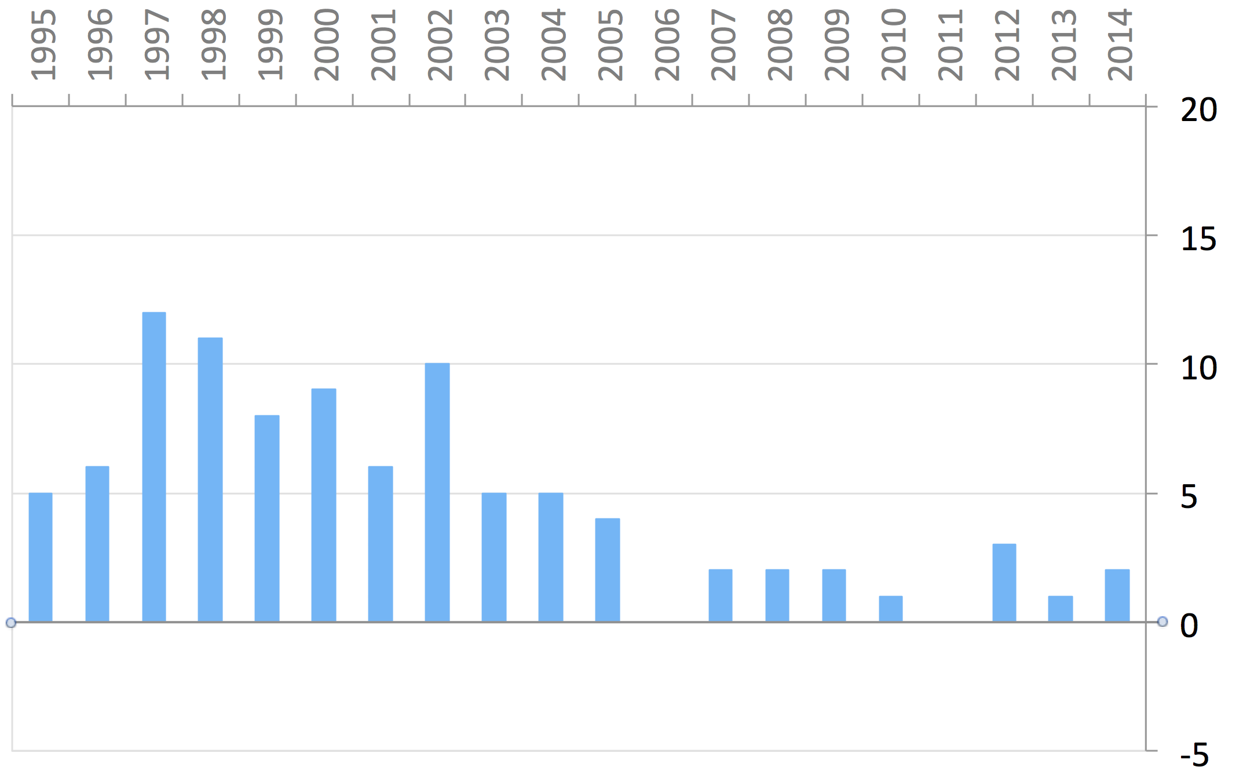
Kristinaskolan, Härnösand
(Number of students by age group)
Started first grade

Slide 23
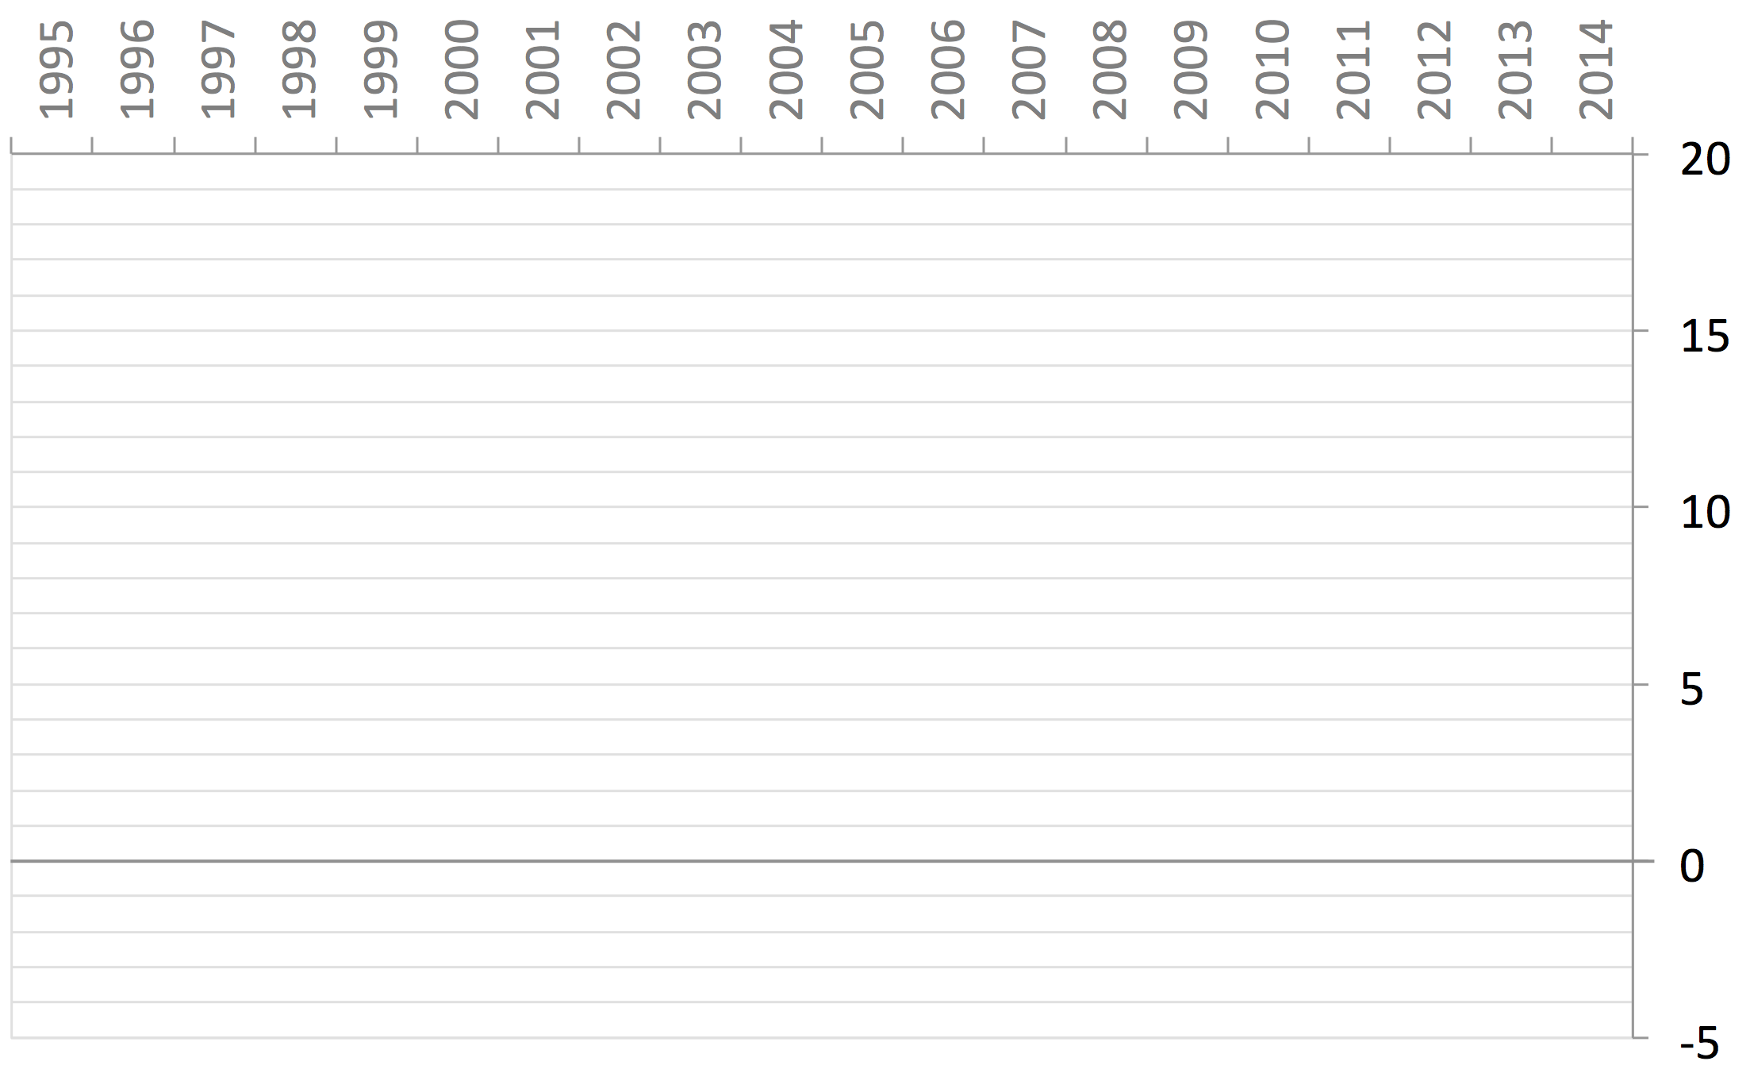
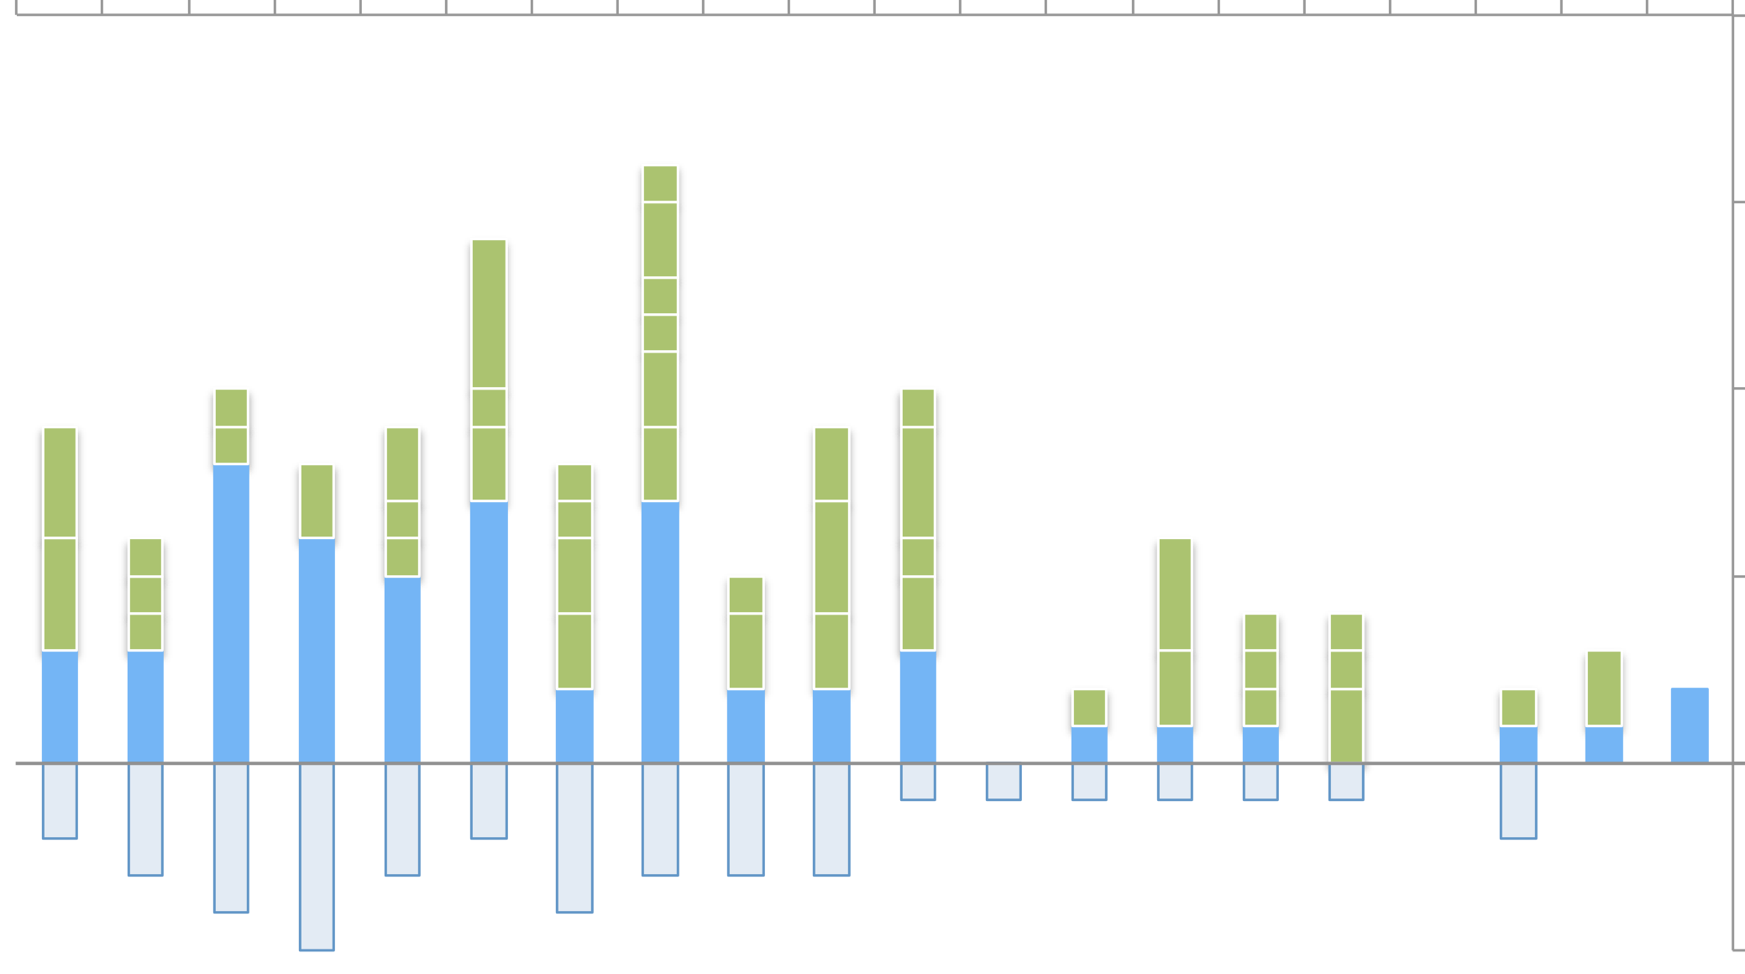
Kristinaskolan, Härnösand
(Number of students by age group)
Started first grade
Arrived later
Dropped out
33 students currently enrolled in grades 1 to 10. Ten of them started school back in 2005, and should leave school next year.
Notice that more students may still arrive late and/or drop out

Slide 24
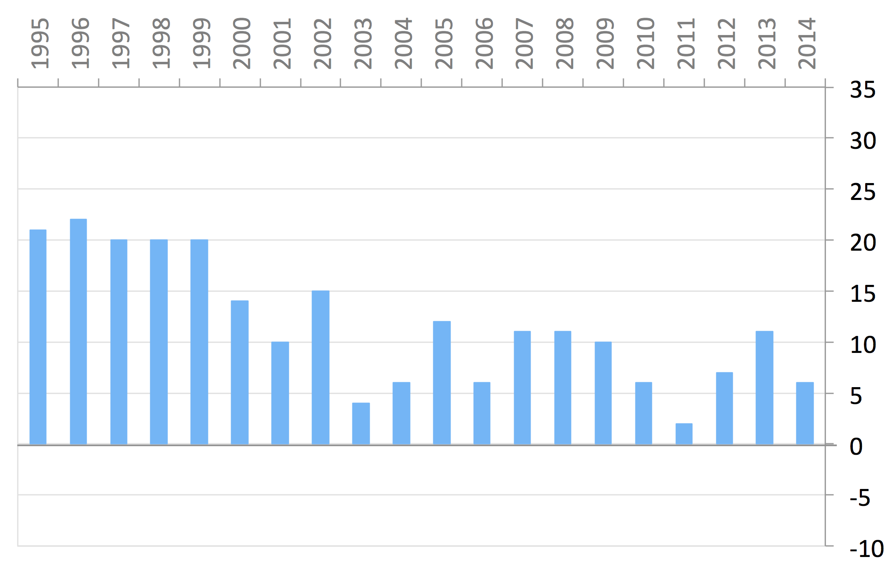
Birgittaskolan, Örebro
(Number of students by age group)
Started first grade

Slide 25
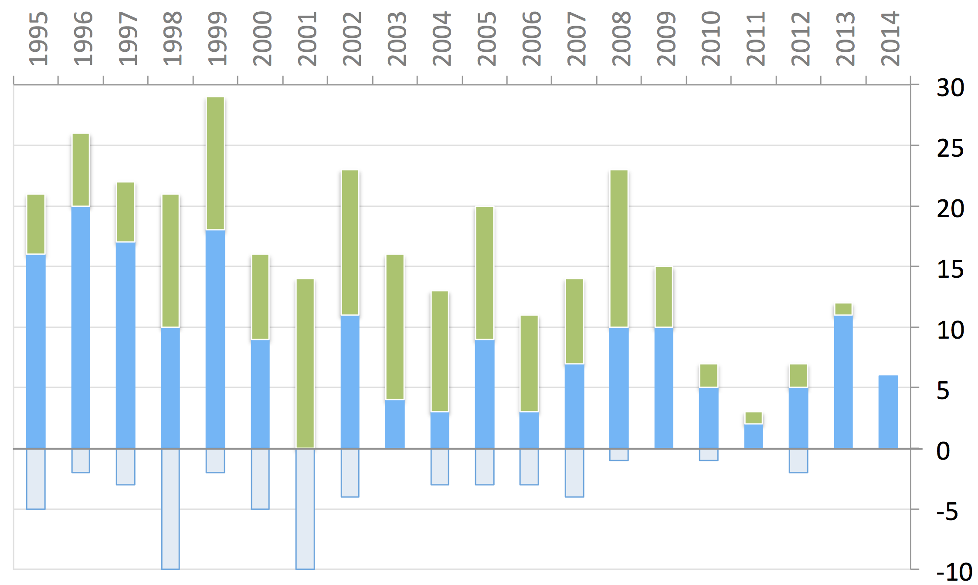
Birgittaskolan, Örebro
(Number of students by age group)
Started first grade
Arrived later
Dropped out
118 students currently enrolled in grades 1 to 10. Notice that more students may still arrive late and/or drop out

Slide 26
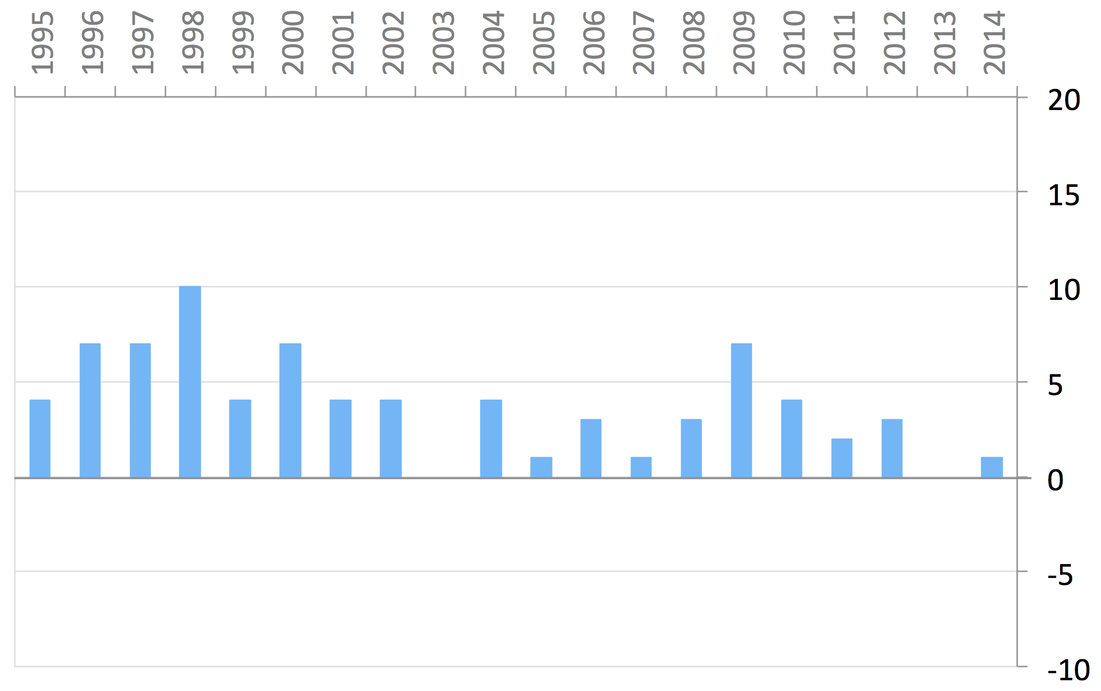
Vänerskolan, Vänersborg
(Number of students by age group)
Started first grade

Slide 27
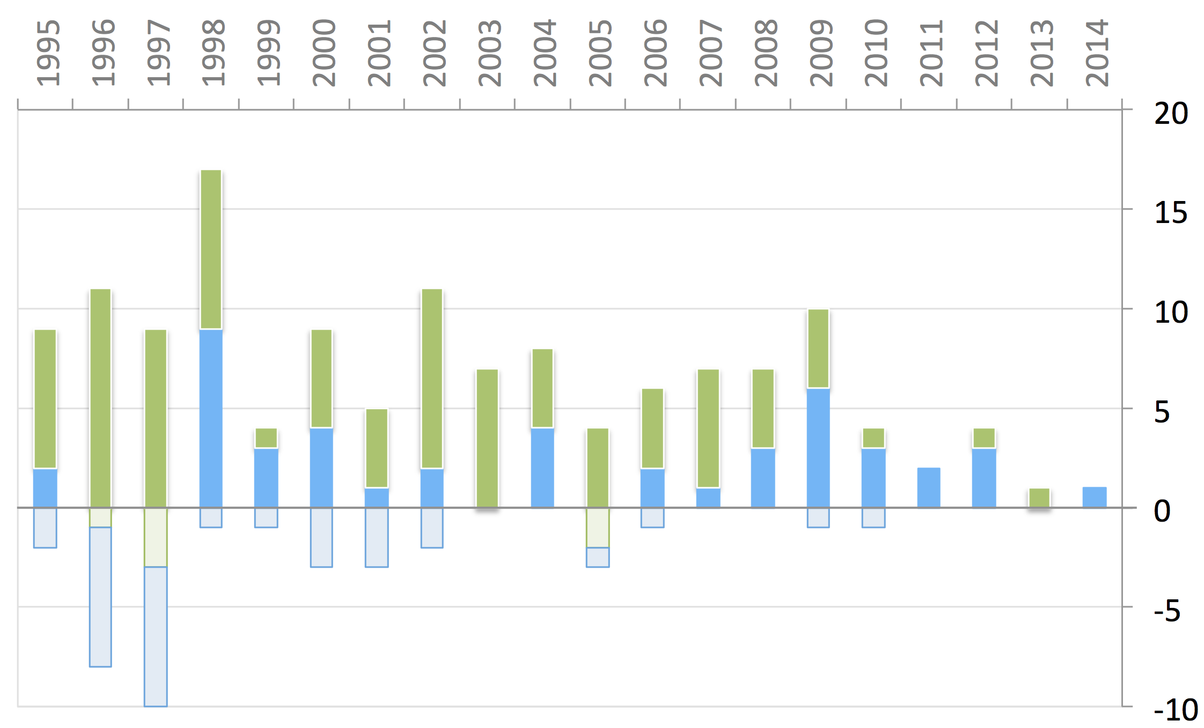
Vänerskolan, Vänersborg
(Number of students by age group)
Started first grade
Arrived later
Dropped out
46 students currently enrolled in grades 1 to 10. Notice that more students may still arrive late and/or drop out

Slide 28
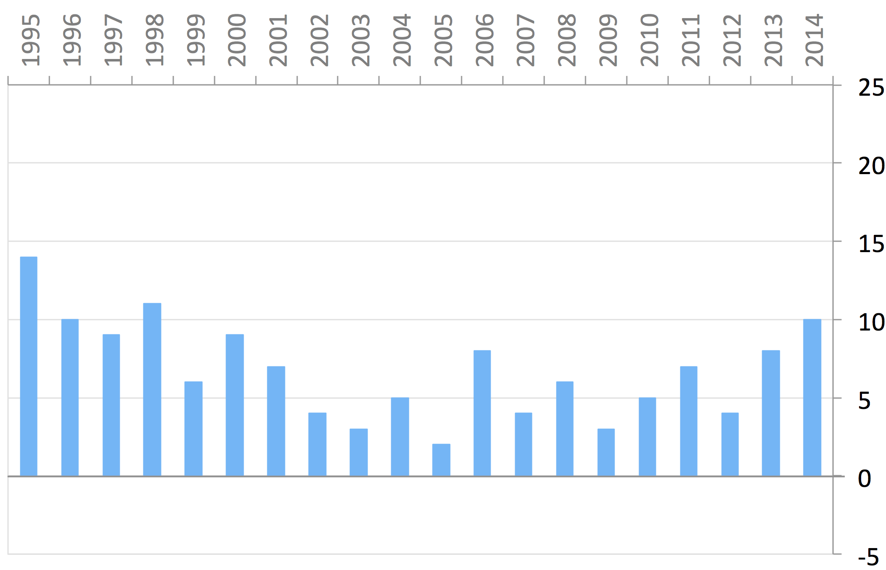
Östervångsskolan, Lund
(Number of students by age group)
Started first grade

Slide 29
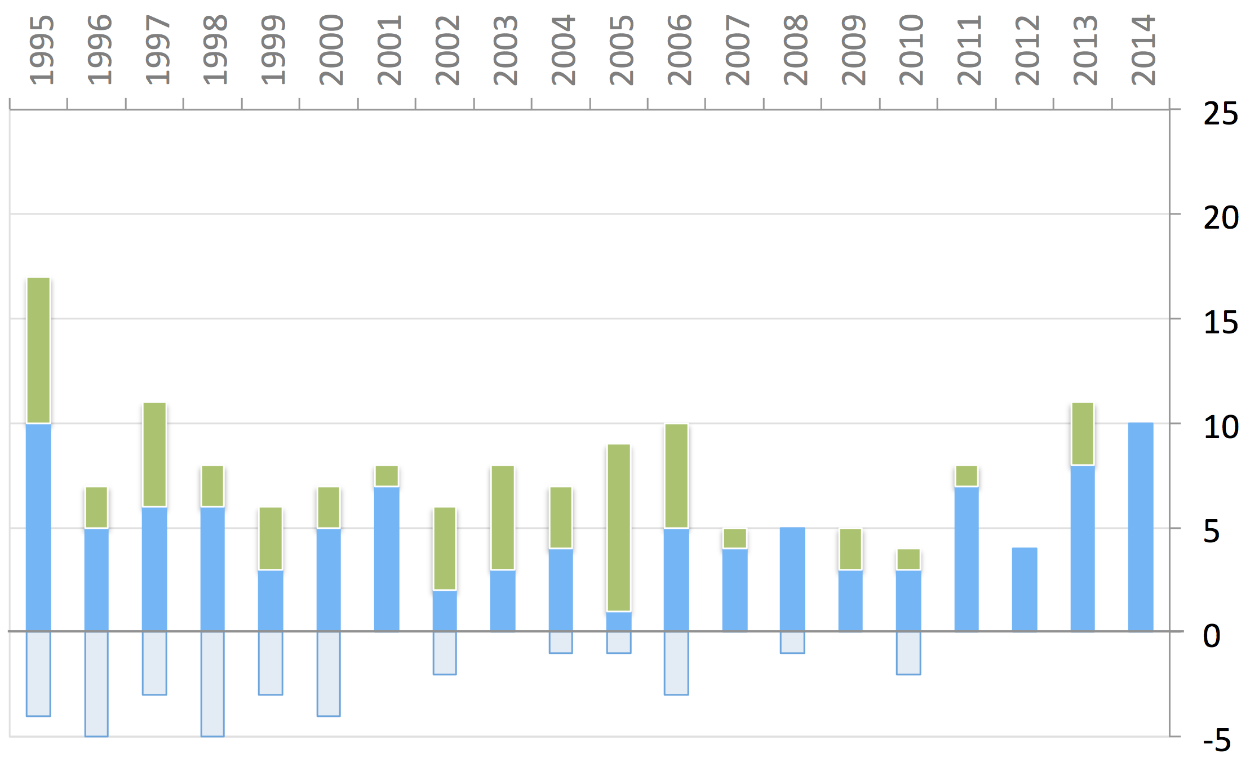
Östervångsskolan, Lund
(Number of students by age group)
Started first grade
Arrived later
Dropped out
Started first grade
71 students currently enrolled in grades 1 to 10. Notice that more students may still arrive late and/or drop out

Slide 30
NEXT COUPLE OF SLIDES ARE ANIMATING
AND SHOULD BE WATCHED IN SLIDESHOWMODE
They Show the graphs of
— FIVE SCHOOLS COMBINED
— KRISTINASKOLAN

Slide 31
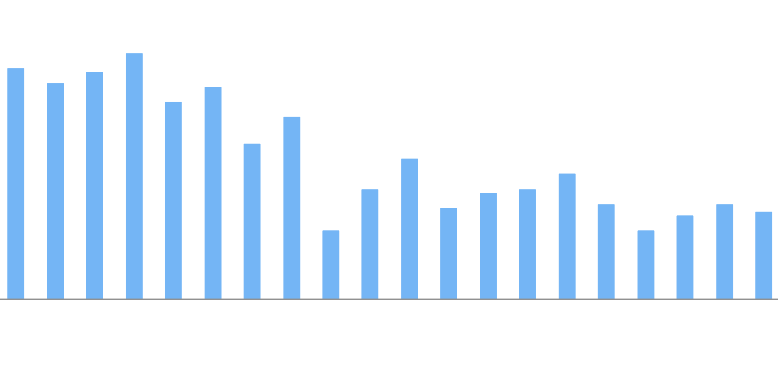
Five Specialskolor
(Number of students by age group)
Started first grade

Slide 32
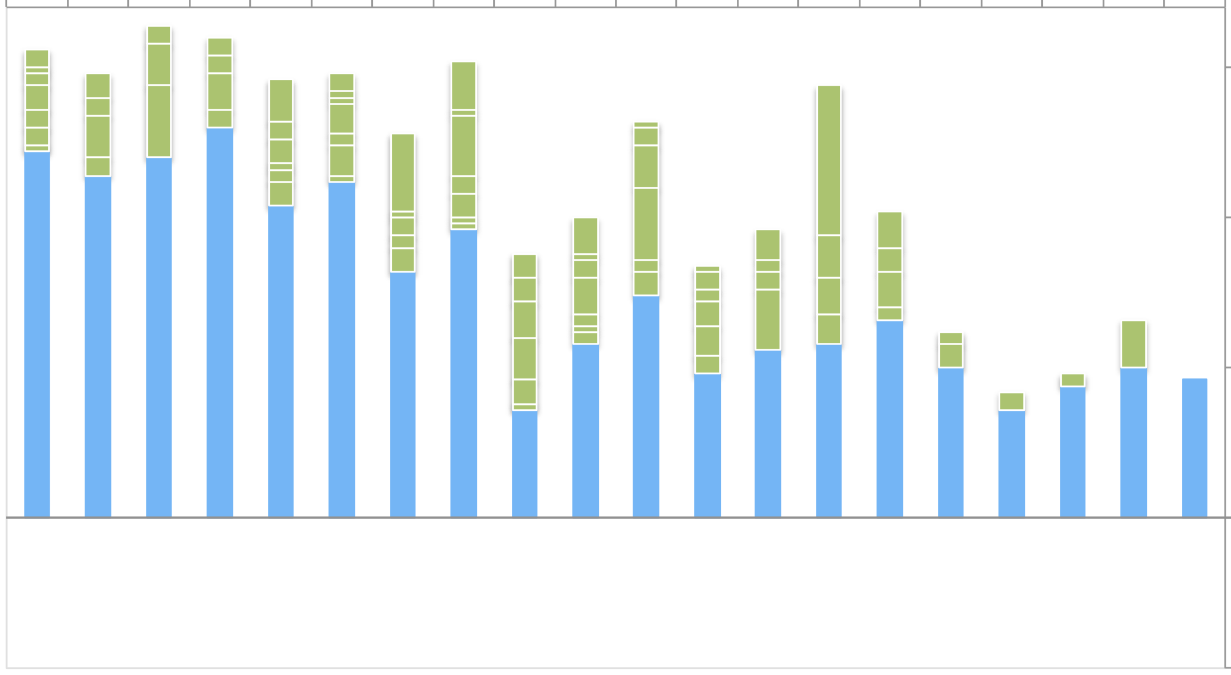
Five Specialskolor
(Number of students by age group)
Started first grade
Arrived later

Slide 33
Five Specialskolor
(Number of students by age group)
Started first grade
Arrived later
Dropped out

Slide 34
Five Specialskolor
(Number of students by age group)
Started first grade
Arrived later
Dropped out
INCOMPLETE DATA
More students will arrive late and drop out

Slide 35
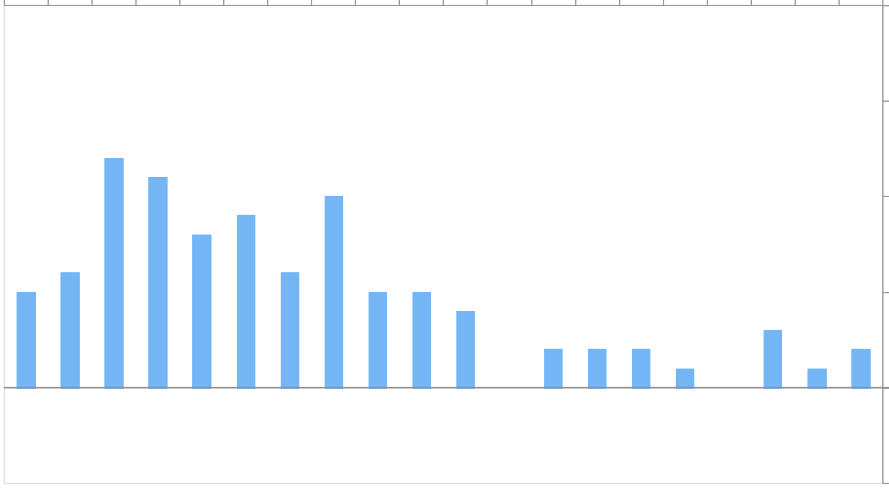
Kristinaskolan, Härnösand
(Number of students by age group)
Started first grade

Slide 36
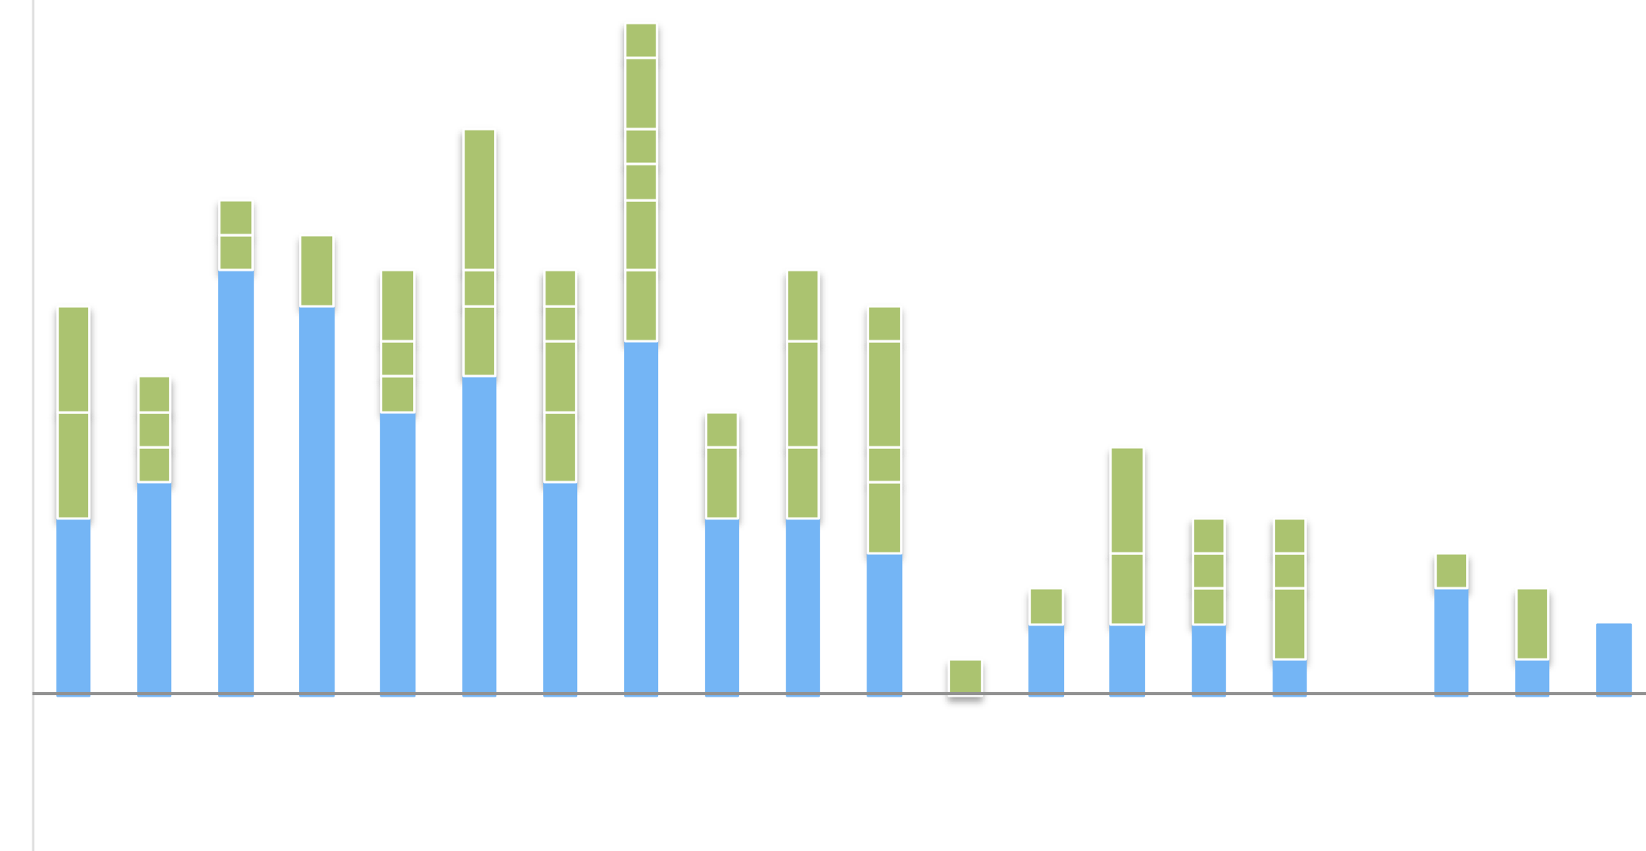
Kristinaskolan, Härnösand
(Number of students by age group)
Started first grade
Arrived later

Slide 37
Kristinaskolan, Härnösand
(Number of students by age group)
Started first grade
Arrived later
Dropped out

Slide 38
Kristinaskolan, Härnösand
(Number of students by age group)
Started first grade
Arrived later
Dropped out
INCOMPLETE DATA
More students will arrive late and drop out

